Slide 1


UNIVERSITY INSTITUTE OF ENGINEERING
COMPUTER SCIENCE & ENGINEERING
Introduction to Information Security
(Subject Code: 20CST-354/20ITT-354)
Prepared By : Er. Puneet kaur (E6913)
INTRODUCTION
DISCOVER . LEARN . EMPOWER

Slide 2

Lecture – 2
Classical Encryption Techniques
www. cuchd.in Campus : Gharaun, Mohali

Slide 3
Classical encryption techniques
As opposed to modern cryptography
Goals:
to introduce basic concepts & terminology of encryption
to prepare us for studying modern cryptography

Slide 4
Basic Terminology
Plaintext: original message to be encrypted
Ciphertext: the encrypted message
Enciphering or encryption: the process of converting plaintext into ciphertext
Encryption algorithm: performs encryption
– Two inputs: a plaintext and a secret key

Slide 5
Basic Terminology
Deciphering or decryption: recovering plaintext from ciphertext
Decryption algorithm: performs decryption
Two inputs: ciphertext and secret key
Secret key: same key used for encryption and decryption
Also referred to as a symmetric key

Slide 6
Basic Terminology
Cipher or cryptographic system : a scheme for encryption and decryption
Cryptography: science of studying ciphers
Cryptanalysis: science of studying attacks against cryptographic systems
Cryptology: cryptography + cryptanalysis

Slide 7
Ciphers
Symmetric cipher: same key used for encryption and decryption
Block cipher: encrypts a block of plaintext at a time (typically 64 or 128 bits)
Stream cipher: encrypts data one bit or one byte at a time
Asymmetric cipher: different keys used for encryption and decryption

Slide 8
Symmetric Cipher Model
A symmetric encryption scheme has five ingredients:
Plaintext
Encryption algorithm
Secret Key
Ciphertext
Decryption algorithm
Security depends on the secrecy of the key, not the secrecy of the algorithm

Slide 9
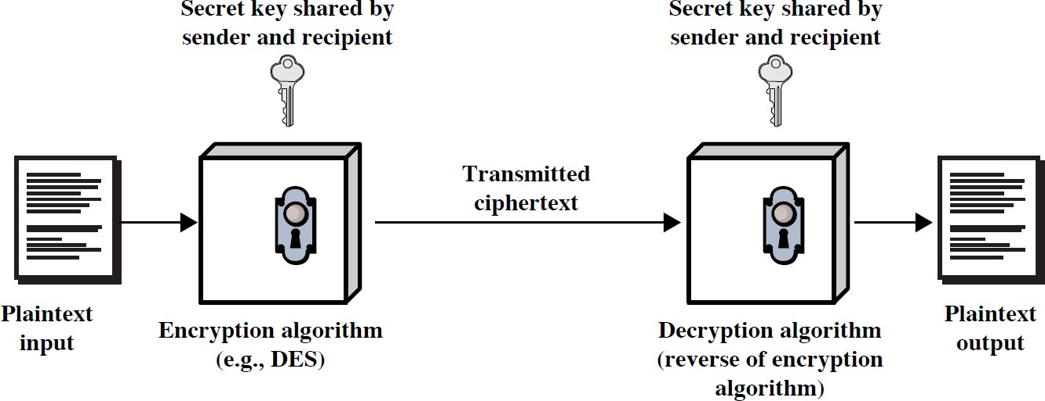
Symmetric Cipher Model

Slide 10
Symmetric Encryption
or conventional / secret-key / single-key
sender and recipient share a common key
all classical encryption algorithms are symmetric
The only type of ciphers prior to the invention of asymmetric-key ciphers in 1970’s
by far most widely used

Slide 11
Symmetric Encryption
Mathematically:
Y = E_{K}(X)
X = D_{K}(Y)
X = plaintext
Y = ciphertext
or Y = E(K, X) or X = D(K, Y)
K = secret key
E = encryption algorithm
D = decryption algorithm
Both E and D are known to public

Slide 12
Symmetric Encryption
two requirements for secure use of symmetric encryption:
a strong encryption algorithm
a secret key known only to sender / receiver
assume encryption algorithm is known
implies a secure channel to distribute key

Slide 13
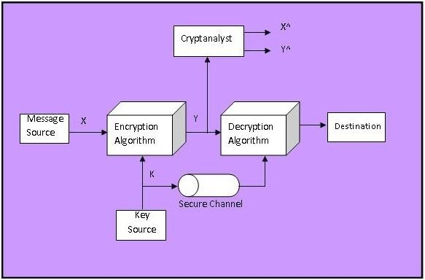
Model of Conventional Cryptosystem

Slide 14
Cryptography
Cryptographic systems are characterized along three independent dimensions:
type of encryption operations used
substitution
Transposition
product
number of keys used
single-key or private
two-key or public

Slide 15
Cryptography
way in which plaintext is processed
block
stream

Slide 16
Cryptanalysis
Objective: to recover the plaintext of a ciphertext
or, more typically, to recover the secret key.
Kerkhoff’s principle: the adversary knows all details about a cryptosystem except the secret key.
Two general approaches:
brute-force attack
non-brute-force attack (cryptanalytic attack)

Slide 17
Brute-Force Attack
Try every key to decipher the ciphertext.
On average, need to try half of all possible keys
Time needed proportional to size of key space
Key Size (bits)
Number of Alternative Keys
Time required at 1 decryption/µs
Time required at 10⁶ decryptions/µs
32 | ₂32
56 | ₂56
128 | ₂128
168 | ₂168
= 4.3 × 10⁹ = 7.2 × 10¹⁶ | 2³¹ µs 2⁵⁵ µs | = 35.8 minutes = 1142 years | 2.15 milliseconds 10.01 hours
= 3.4 × 10³⁸ | ₂127 _{µs} | = 5.4 × 10²⁴ years | 5.4 × 10¹⁸ years
= 3.7 × 10⁵⁰ | ₂167 _{µs} | = 5.9 × 10³⁶ years | 5.9 × 10³⁰ years
26 characters (permutation)
26! = 4 × 10²⁶
2 × 10²⁶ µs = 6.4 × 10¹² years
6.4 × 10⁶ years

Slide 18
Cryptanalytic Attacks
Attack Type Ciphertext only
Knowledge Known to Cryptanalyst
Encryption algorithm
Ciphertext to be decoded
Encryption algorithm
Ciphertext to be decoded
One or more plaintext-ciphertext pairs formed with the same secret key
Encryption algorithm
Ciphertext to be decoded
Plaintext message chosen by cryptanalyst, together with its corresponding ciphertext generated with the same secret key
Known Plaintext
Chosen Plaintext
Chosen Ciphertext
Encryption algorithm
Ciphertext to be decoded
Purported ciphertext chosen by cryptanalyst, together with its corresponding decrypted plaintext generated with the secret key
Encryption algorithm
Ciphertext to be decoded
Plaintext message chosen by cryptanalyst, together with its corresponding ciphertext generated with the secret key
Purported ciphertext chosen by cryptanalyst, together with its corresponding decrypted plaintext generated with the secret key
Chosen text

Slide 19
Cryptanalytic Attacks
May be classified by how much information needed by the attacker:
Ciphertext-only attack
Known-plaintext attack
Chosen-plaintext attack
Chosen-ciphertext attack
Chosen text

Slide 20
Ciphertext-only attack
Given: a ciphertext c
Q: what is the plaintext m?
An encryption scheme is completely insecure if it cannot resist ciphertext-only attacks.

Slide 21
Known-plaintext attack
Given: (m₁,c₁), (m₂,c₂), …, (m_{k},c_{k}) and a new ciphertext c.
Q: what is the plaintext of c?
Q: what is the secret key in use?

Slide 22
Chosen-plaintext attack
Given: (m₁,c₁), (m₂,c₂), …, (m_{k},c_{k}), where
m₁, m₂, …, m_{k} are chosen by the adversary; and a new ciphertext c.
Q: what is the plaintext of c, or what is the secret key?

Slide 23
Computational Security
An encryption scheme is computationally secure if
The cost of breaking the cipher exceeds the value of information
The time required to break the cipher exceeds the lifetime of information

Slide 24
Unconditional Security
No matter how much computer power or time is available, the cipher cannot be broken since the ciphertext provides insufficient information to uniquely determine the corresponding plaintext
All the ciphers we have examined are not unconditionally secure.

Slide 25
Classical Ciphers
Plaintext is viewed as a sequence of elements (e.g., bits or characters)
Substitution cipher: replacing each element of the plaintext with another element.
Transposition (or permutation) cipher: rearranging the order of the elements of the plaintext.
Product cipher: using multiple stages of substitutions and transpositions

Slide 26
References
http://www.brainkart.com/article/Classical-Encryption-Techniques_8339/
https://www.tutorialspoint.com/cryptography/index.htm
https://www.geeksforgeeks.org/cryptography-introduction/
https://www.techopedia.com/definition/1770/cryptography#:~:text=Cryptography%20involves%20creating%20written%20or,information%20to%20be%20kept%20secret.&text=Information%20security%20uses%20cryptography%20on,transit%20and%20while%20being%20stored.
https://www2.slideshare.net/lineking/classical-encryption-techniques-in-network-security?qid=e388c29f-793d-4f2b-bcaf-9d22e9ca07b5&v=&b=&from_search=1

